Slide 1
Advanced Generative AI
Unisole Empower

Slide 2
Objectives of the Course
End-to-End GenAI Lifecycle & Deployment: Master the complete generative AI lifecycle from initial use-case definition to securely deploying production-grade models on managed infrastructure like Amazon SageMaker, Bedrock, and the Hugging Face Model Hub.
Model Adaptation, Tuning, & Alignment: Learn to customize massive foundation models for specific domains using prompt engineering, Parameter-Efficient Fine-Tuning (PEFT), and Reinforcement Learning from Human Feedback (RLHF), backed by rigorous evaluation protocols.
Advanced Architectures (RAG & Agents): Build sophisticated AI applications by architecting context-aware Retrieval-Augmented Generation (RAG) pipelines and developing autonomous, multi-step AI agents using frameworks like LangChain and ReAct.
Multimodal Generative AI: Expand generative capabilities beyond standard text processing by implementing, evaluating, and fine-tuning multimodal models that handle image, audio, and video formats.

Slide 3
Prerequisites of the course
Python & ML Framework Proficiency: Strong, hands-on coding experience with Python and practical working knowledge of industry-standard deep learning libraries, specifically PyTorch or TensorFlow.
Deep Learning & NLP Foundations: A solid conceptual grasp of neural network mechanics (including forward/backpropagation, gradients, and activation functions) and basic familiarity with how language models process data.
API Integration & Systems Logic: Comfort interacting with external data sources and web APIs, along with the ability to understand application-level frameworks to manage how data flows through multi-step programmatic architectures.
Basic Cloud Literacy: A high-level understanding of cloud computing environments; while deep AWS expertise is not strictly required to grasp the concepts, foundational knowledge will significantly aid in the infrastructure and deployment modules.

Slide 4
Use Cases and Tasks
Text Summarization, Rewriting, Information Extraction
Question Answering (QA) and Visual Question answering, detecting toxic and harmful content
Classification and Content Moderation, Source Code generation, translation
Mask personally identifiable information (PII), Personalized marketing and ads

Slide 5
Foundational Models and Model Hubs
Foundational models are pre-trained upon massive amount of data.
Model hubs include hugging face, pytorch hub, amazon sagemaker jumpstart and many more.

Slide 6
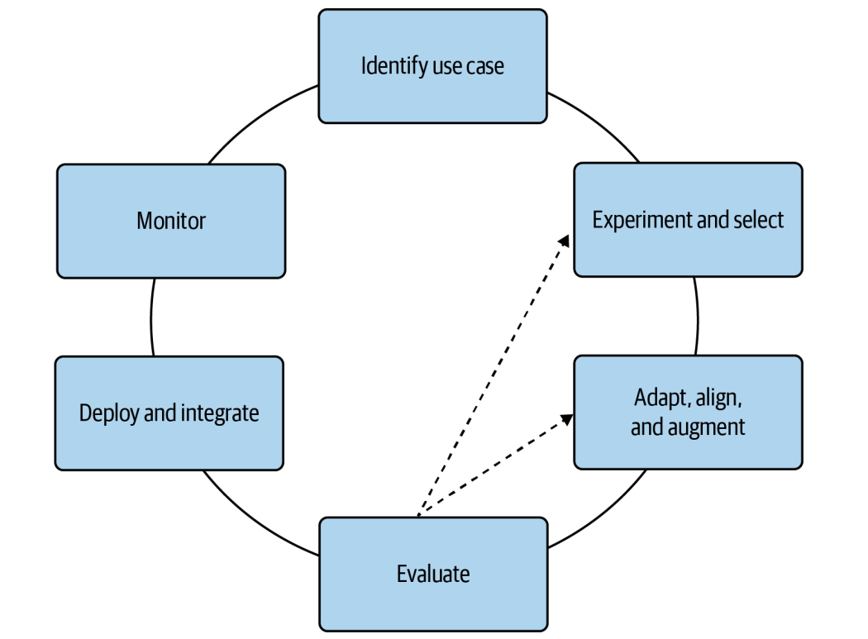
Generative AI lifecycle

Slide 7
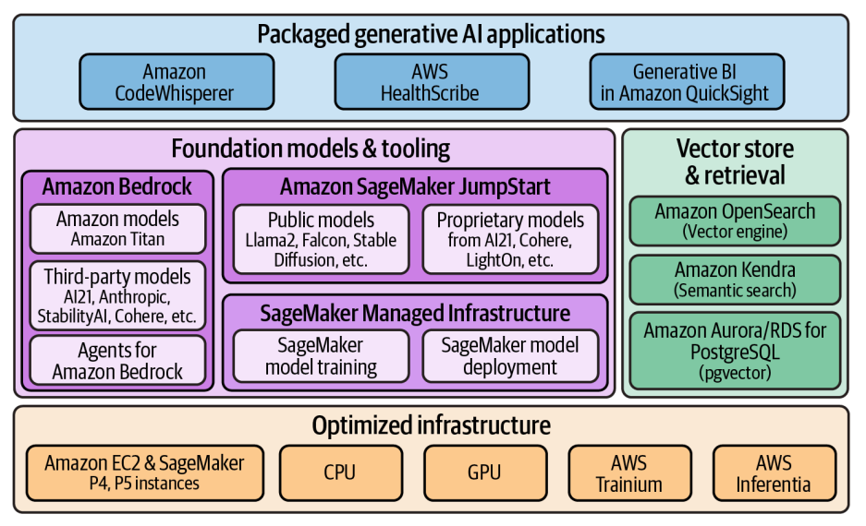
AWS for Generative AI
AWS offers a range of frameworks and infrastructure to build foundation models.
Amazon SageMaker for model training and model deployment.
AWS offers its own accelerators optimized for training (AWS Trainium) and deploying generative models (AWS Inferentia).

Slide 8
Amazon Bedrock
Amazon Bedrock is a fully managed service that provides access to models from Amazon (e.g., Titan) and popular third-party providers (e.g., AI21 Labs, Anthropic, Cohere, and Stability AI).
This allows us to quickly get started experimenting with available foundation models.
Bedrock also allows us to privately customize foundation models with our own data as well as integrate and deploy those models into generative AI applications.
Agents for Bedrock are fully managed and allow for additional customization with the integration of proprietary external data sources and the ability to complete tasks.

Slide 9
Amazon SageMaker JumpStart
Amazon SageMaker JumpStart provides access to both public and proprietary foundation models through a model hub that includes the ability to easily deploy a foundation model to Amazon SageMaker model deployment real-time endpoints.
SageMaker JumpStart provides the ability to fine-tune available models utilizing SageMaker model training.
SageMaker JumpStart automatically generates notebooks with code for deploying and fine-tuning models available on the model hub.

Slide 10
Why Generative AI on AWS?
Increased flexibility and choice
Enterprise-grade security and governance capabilities
State-of-the-art generative AI capabilities
Low operational overhead
Strong history of continuous innovation

Slide 11
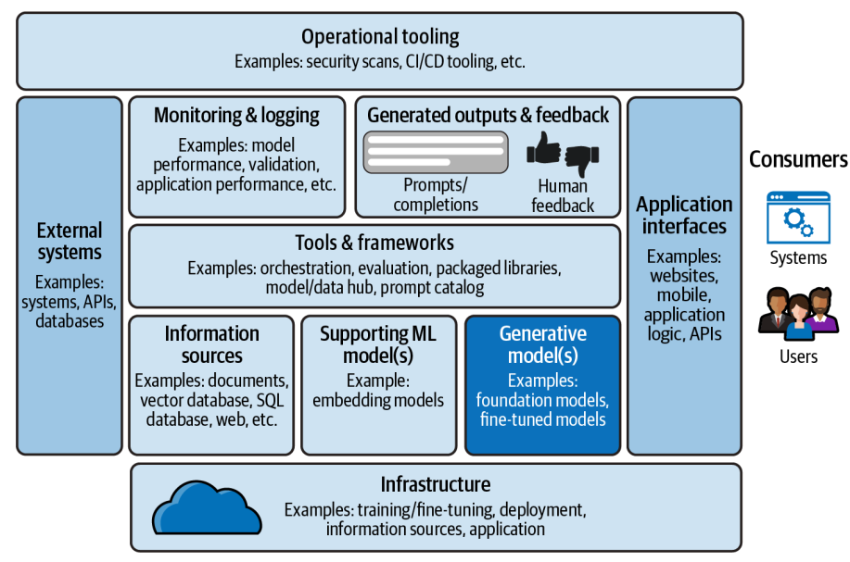
Building Generative AI Applications on AWS

Slide 12
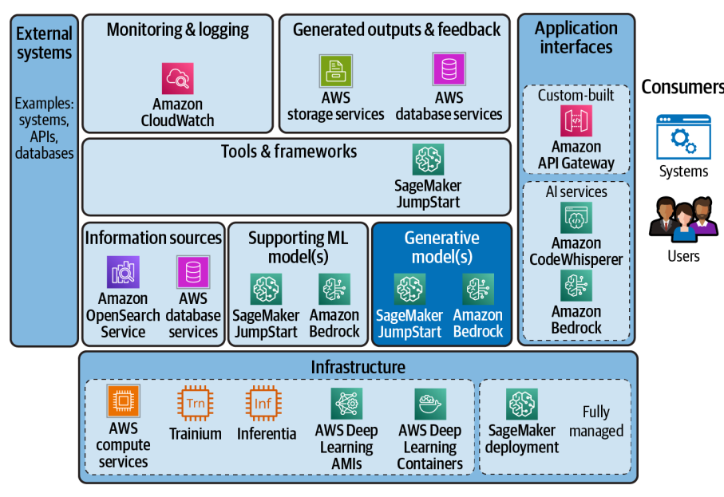

Slide 13
Where We Are: Recap & What's Next
What we covered (Slides 1–12)
Course objectives, prerequisites, and generative AI use cases & tasks
Foundation models, model hubs, and the generative AI project lifecycle
Building generative AI on AWS: Amazon Bedrock and SageMaker JumpStart
What's next: Chapter 2 — Prompt Engineering & In-Context Learning
Prompts, completions, and tokens — how models read and write text
Prompt structure, in-context learning (zero / one / few-shot)
Prompt-engineering best practices, chain-of-thought, and inference parameters

Slide 14
Chapter 2
Prompt Engineering & In-Context Learning

Slide 15
Prompts & Completions
A prompt is the text input you send to the model — instructions, context, and constraints for a task
The model returns a completion — text, image, video, or audio it was trained to produce
Expect to iterate: models can be "chatty," so refine prompts to get a precise response
Prompt
instructions + context + input
Model
inference
Completion
generated output

Slide 16
Tokens
Models don't read words — they convert text into tokens (word fragments)
A model's vocabulary is typically 30,000–100,000 tokens — enough to represent any text
Rule of thumb: ~1.3 tokens per word — used to estimate cost (often priced per million tokens)
Math under the hood: tokens become numbers for probability and matrix operations
"tokenization"
token
iz
ation
= 3 tokens

Slide 17
Prompt Engineering
The skill of crafting prompts to get the most out of a generative model — part art, part science
Chat models use input / output indicators to mark user vs. model turns
Prompt structure is model-specific — always check the model card before experimenting
The context window caps total input + output tokens and varies widely by model:
FLAN-T5
512
tokens
Falcon
2,048
tokens
Llama 2
4,096
tokens
Claude
100,000
tokens

Slide 18
Prompt Structure: The Four Parts
Instruction
What you want the model to do (e.g. “Summarize the text”)
Context
Background info & few-shot examples that frame the task
Input Data
The actual content the model should act on
Output Indicator
Cue that signals where the model’s answer begins

Slide 19
In-Context Learning
Add example prompt-completion pairs to the context so the model learns on the fly — without changing its weights.
Zero-shot
0 examples
Model relies on prior knowledge to generalize to unseen tasks. Largest models do this surprisingly well.
One-shot
1 example
A single prompt-completion pair guides the response toward the desired format.
Few-shot
2–5+ examples
Several consistent examples; the model closely follows their pattern. Smaller models benefit most.

Slide 20
In-Context Learning: Tips & Limits
Best practices
Start with zero-shot; move to one- or few-shot only if results fall short
Use consistent, representative examples — and keep within the context window
Watch out
Mislabeled examples can "trick" the model into the wrong behavior — double-check pairs
Still stuck after 5–6 examples? Switch models, fine-tune, or use RAG (retrieval-augmented generation)

Slide 21
Prompt-Engineering Best Practices
Be clear & concise. If it confuses a human, it confuses the model.
Be creative. Novel prompts can yield better, surprising results.
Put the instruction last when the input text is long.
Convey the subject clearly. State who, what, where, when, why, how.
Use explicit directives. “Summarize in a single sentence:”
Avoid negatives. “in 5 sentences or less” > “no more than 5.”
Specify size & format. “List the top 3…”, give an example layout.
Add context & few-shot examples. Frame the task.
Allow “I don’t know.” Reduces hallucinated answers.
Add constraints & evaluate. Limit length/format, then review output.

Slide 22
Hallucinations & Chain-of-Thought
⚠ Hallucination
The model confidently states something false. Reducing max tokens only hides it — it doesn’t fix it.
☞ Chain-of-Thought
Ask the model to “think step-by-step” so it reasons through complex tasks and finds the right answer.
Question
Step 1
Step 2
Correct Answer

Slide 23
Inference Parameters: Sampling
Max new tokens — caps the length of the response. Note: it does not prevent hallucinations, only shortens them.
Greedy Sampling
Always picks the highest-probability token
Simple; the default in most models
Can repeat words on longer text
Random Sampling
Picks via weighted random across tokens
More natural, less repetition
Risk: may drift off-topic if too creative

Slide 24
Top-k, Top-p & Temperature
Top-k
Sample only from the k highest-probability tokens. Higher k → more variety; k = 1 is greedy.
Top-p
Sample from the smallest set whose cumulative probability ≤ p. Adapts to the distribution.
Temperature
Reshapes the whole distribution. Low → focused & repetitive; high → flat & creative.
Limits to k best tokens
Cumulative probability ≤ p
Start around 0.8

Slide 25
Chapter 2 Summary
What you learned
Models read and write tokens; prompts have a clear structure: instruction, context, input data, output indicator
In-context learning (zero/one/few-shot) steers behavior for a single request — no weights change
Clear prompts, chain-of-thought, and inference params (max tokens, top-k, top-p, temperature) shape the output
Coming up next
These techniques don’t change model weights — next we fine-tune models on your own data

